Slide 1
专业外语
软件工程 物联网
2023-3-1

Slide 2
PART 1 COMPUTER ARCHITETURE AND COMPUTER NETWORK CHAPTER 3 Computer Network 3.1 LOCAL AREA NETWORKS (LANs) 3.1.1 ETHERNET

Slide 3
KEYWORDS
LAN (Local Area Network) 局域网
WAN (Wide Area Network) 广域网
telecommunication 电信，远程通信
twisted pair 双绞线（对）
Wi-Fi (Wireless Fidelity) 无线保真
network topology 网络拓扑(结构)
ring 环
bus 总线
mesh 网格

Slide 4
star 星型
Switched Ethernet 交换式以太网
switch 交换机
router 路由器
cable modem 电缆调制解调器
ADSL (Asymmetric Digital Subscriber Line)
非对称数字用户线
link 链接，链路
redundant links 冗余链路

Slide 5
spanning tree 生成树
loop 环，环路
traffic 通信数据量，业务量
QoS (Quality of Service) 质量保证
firewall 防火墙
load balance 负载均衡
sensor 传感器
leased 租用
VPN(Virtual Private Network) 虚拟专用网

Slide 6
hub 集线器
bridge 桥，网桥
MAC (Medium Access Control)
媒体访问（接入，存取）控制
packet switching 分组交换
forward 转发
broadcasting 广播
port 端口，移植
Gigabit 吉比特，吉位

Slide 7
Tb (Terabit) 太[拉]位
frame 帧
full-duplex 全双工，双向同时通讯
half-duplex 半双工通讯，双向交替通讯
point-to-point 点对点
shared-medium 共享媒体

Slide 8
3.1.1 ETHERNET
A local area network (LAN) is a computer network that interconnects computers within a limited area such as a home, school, computer laboratory, or office building, using network media. The defining characteristics of LANs, in contrast to wide area networks (WANs), include their smaller geographic area, and non-inclusion of leased telecommunication lines.
ARCNET, Token Ring and other technology standards have been used in the past, but Ethernet over twisted pair cabling, and Wi-Fi are the two most common technologies currently used to build LANs.

Slide 9
Network topology describes the layout of interconnections between devices and network segments. At the Data Link Layer and Physical Layer, a wide variety of LAN topologies have been used, including ring, bus, mesh and star, but the most common LAN topology in use today is switched Ethernet.
At the higher layers, the Internet Protocol (TCP/IP) has become the standard, replacing NetBEUI, IPX/SPX, AppleTalk and others.

Slide 10
Simple LANs generally consist of one or more switches.
A switch can be connected to a router, cable modem, or ADSL modem for Internet access.
Complex LANs are characterized by their use of redundant links with switches using the spanning tree protocol to prevent loops, their ability to manage differing traffic types via quality of service (QoS), and to segregate traffic with VLANs.
A LAN can include a wide variety of network devices such as switches, firewalls, routers, load balancers, and sensors.

Slide 11
LANs can maintain connections with other LANs via leased lines, leased services, or the Internet using virtual private network (VPN) technologies.

Slide 12
1. Network switch
A network switch (also called switching hub, bridging hub, officially MAC bridge) is a computer networking device that connects devices together on a computer network (Figure 3-1), by using packet switching to receive, process and forward data to the destination device.
Unlike less advanced network hubs, a network switch forwards data only to one or multiple devices that need to receive it, rather than broadcasting the same data to each of its ports.

Slide 13
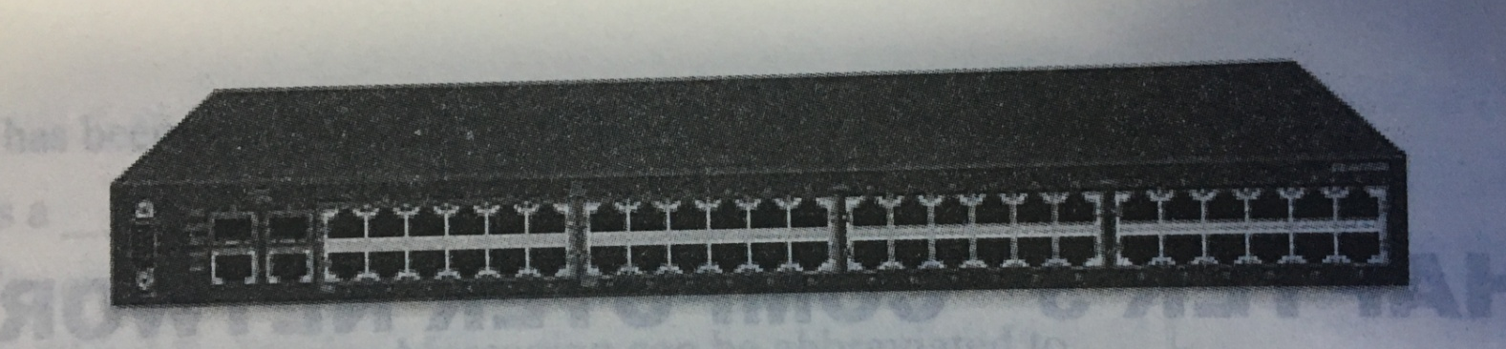
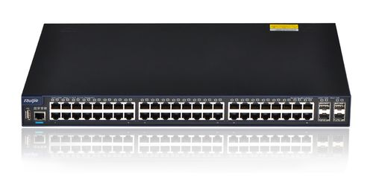
Figure 3-1 Avaya ERS 2550T-PWR, a 50-port Ethernet switch.
From the Internet

Slide 14
2. 10 Gigabit Ethernet
10 Gigabit Ethernet (10GE, 10GbE, or 10 GigE) is a group of computer networking technologies for transmitting Ethernet frames at a rate of 10 gigabits per second (10×10⁹ or 10 billion bits per second).
It was first defined by the IEEE 802.3ae-2002 standard.

Slide 15
Unlike previous Ethernet standards, 10 Gigabit Ethernet defines only full duplex point-to-point links which are generally connected by network switches; shared-medium CSMA/CD operation has not been carried over from the previous generations Ethernet standards.
Half duplex operation and hubs do not exist in 10GbE.

Slide 16
3. Terabit Ethernet
Facebook and Google, among other companies, have expressed a need for TbE.
Some think that a speed of 400 Gbit/s is a more practical goal than 1 Tbit/s (1000 Gbit/s).
In 2011 researchers predicted Terabit Ethernet (1 Tbit/s) in 2015, and 100 Terabit Ethernet (100 Tbit/s) by 2020.

Slide 17
3.1.2 WI-FI BLUETOOTH

Slide 18
KEYWORDS
Wi-Fi (Wireless Fidelity) 无线保真
UHF (Ultra High Frequency) 特高频
SHF (Super-High Frequency) 超高频
ISM (Industrial Science Medicine)
工业、科学和医用频段
WLAN (Wireless Local Area Network)
虚拟局域网
certified 已证明无误的，合格的
video-game console 电视游戏控制台

Slide 19
smartphone 智能手机
digital camera 数码相机
tablet computer 平板电脑
digital audio player 数字音频播放器
access point 接入点，存取点，访问点
hotspot 热点
radio wave 无线电波
overlap 重叠，部分重叠
intruder 侵入者，干扰者

Slide 20
SSL (Secure Sockets Layer) 安全套接层
detect 检测，探测，检波
encryption 加密
unencryption 解密
flaw 缺陷，瑕疵，裂缝，故障
router 路由器
password 密码，口令
certification 证明（书），认可
Bluetooth 蓝牙

Slide 21
PAN (Personal Area Network) 个人区域网
telecom 电信，远程通信
vendor 自动售货机，卖主，厂商，供应商
qualification 资格，限定，合格性
protect 保护，防御
consumption 消费，消耗
transceiver 收发器，收发信机
microchip 微[芯]片
line of sight 视线，视距

Slide 22
thermostat 自动调温器
complementary 互补的，互余的，附加的
optical wireless 光无线电
symmetrical 对称的
asymmetrical 非对称的
client-server 客户-服务器
configuration 配置，排列，结构，外形，形状
suit 一套，一组，适合于
access node 访问节点，接入节点

Slide 23
1. Wi-Fi
Wi-Fi (or, incorrectly but commonly, WiFi) is a local area wireless technology that allows an electronic device to participate in computer networking using 2.4GHz UHF and 5GHz SHF ISM radio bands.

Slide 24
The Wi-Fi Alliance defines Wi-Fi as any “wireless local area network” (WLAN) product based on the Institute of Electrical and Electronics Engineers’ (IEEE) 802.11 standards.
However, the term “Wi-Fi” is used in general English as a synonym for “WLAN” since most modern WLANs are based on these standards. “Wi-Fi” is a trademark of the Wi-Fi Alliance.
The “Wi-Fi CERTIFIED” trademark can only be used by Wi-Fi products that successfully complete Wi-Fi Alliance interoperability certification testing.

Slide 25
Many devices can use Wi-Fi, e.g. personal computers, video-game consoles, smartphones, digital cameras, tablet computers and digital audio players.
These can connect to a network resource such as the Internet via a wireless network access point.
Such an access point (or hotspot) has a range of about 20 meters (66 feet) indoors and a greater range outdoors.

Slide 26
Hotspot coverage can comprise an area as small as a single room with walls that block radio waves, or as large as many square kilometers achieved by using multiple overlapping access points.
Figure 3-2 depicts the communication course between a notebook and a printer through an access point.

Slide 27
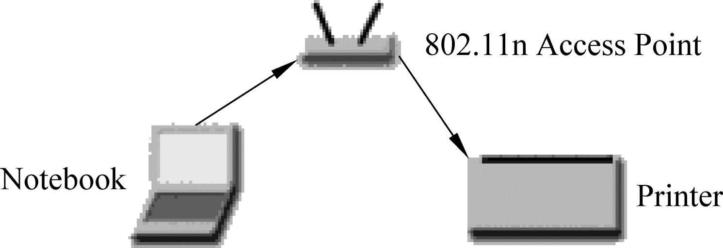
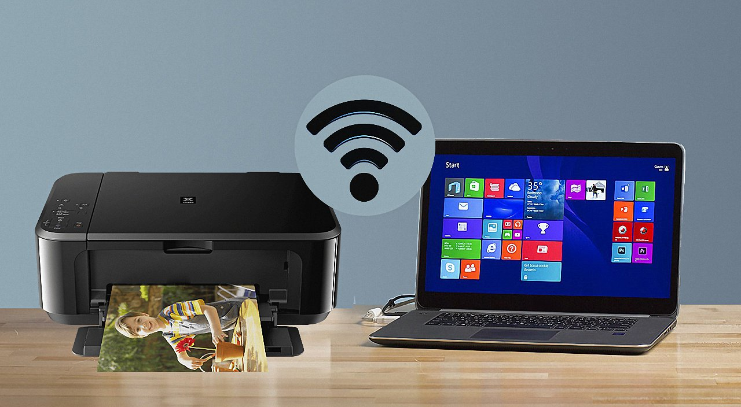
Figure 3-2 Depiction of a device sending information wirelessly to another device, both connected to the local network, in order to print a document.
From the Internet

Slide 28
Wi-Fi can be less secure than wired connections, such as Ethernet, because an intruder does not need a physical connection.
Web pages that use SSL are secure but unencrypted internet access can easily be detected by intruders.
Because of this, Wi-Fi has adopted various encryption technologies.
The early encryption WEP proved easy to break.

Slide 29
Higher quality protocols (WPA, WPA2) were added later.
An optional feature added in 2007, called Wi-Fi Protected Setup (WPS), had a serious flaw that allowed an attacker to recover the router’s password.
The Wi-Fi Alliance has since updated its test plan and certification program to ensure all newly certified devices resist attacks.

Slide 30
2. Bluetooth
Bluetooth is a wireless technology standard for exchanging data over short distances (using short-wavelength UHF radio waves in the ISM band from 2.4 to 2.485GHz) from fixed and mobile devices, and building personal area networks (PANs).
Invented by telecom vendor Ericsson in 1994, it was originally conceived as a wireless alternative to RS-232 data cables.
It can connect several devices, overcoming problems of synchronization

Slide 31
Bluetooth is managed by the Bluetooth Special Interest Group (SIG), which has more than 25,000 member companies in the areas of telecommunication, computing, networking, and consumer electronics.

Slide 32
The IEEE standardized Bluetooth as IEEE 802.15.1, but no longer maintains the standard.
The Bluetooth SIG oversees development of the specification, manages the qualification program, and protects the trademarks.
A manufacturer must make a device to meet Bluetooth SIG standards, and to market it as a Bluetooth device

Slide 33
Bluetooth is a standard wire-replacement communications protocol primarily designed for low-power consumption, with a short range based on low-cost transceiver microchips in each device.

Slide 34
Because the devices use a radio (broadcast) communications system, they do not have to be in visual line of sight of each other, however a quasi optical wireless path must be viable.
Range is power-class-dependent, but effective ranges vary in practice; see Figure 3-3.

Slide 35
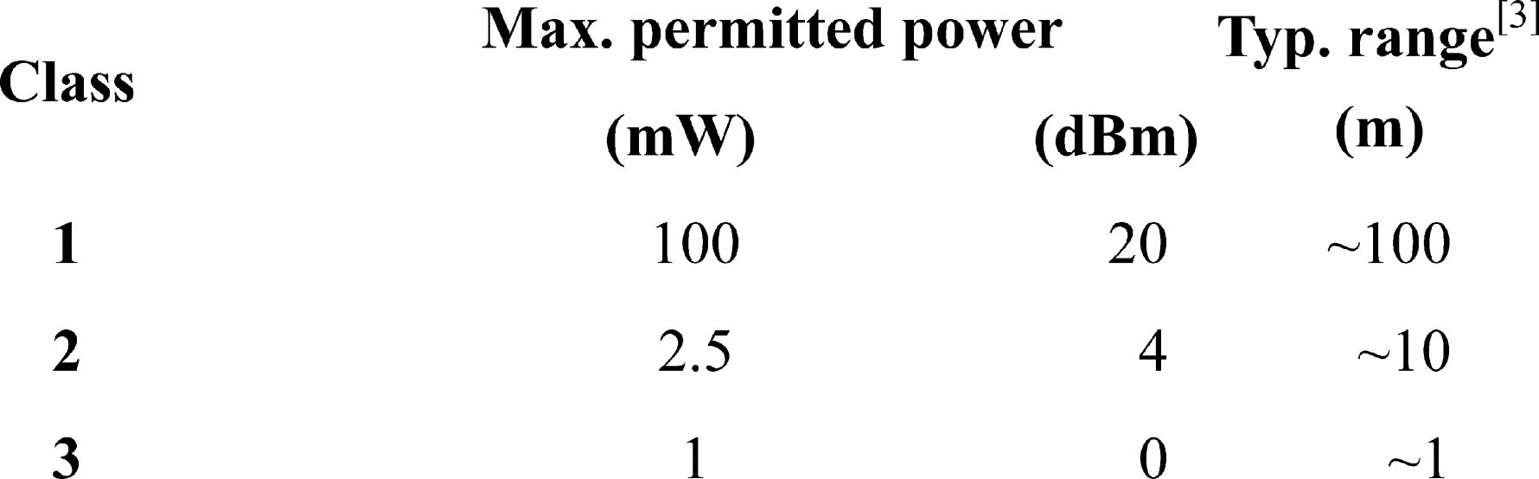
Figure 3-3 Class of Bluetooth

Slide 36
3. Bluetooth vs. Wi-Fi
Bluetooth and Wi-Fi have some similar applications: setting up networks, printing, or transferring files. Wi-Fi is intended as a replacement for high speed cabling for general local area network access in work areas.
This category of applications is sometimes called wireless local area networks (WLAN).

Slide 37
Bluetooth was intended for portable equipment and its applications.
The category of applications is outlined as the wireless personal area network (WPAN).
Bluetooth is a replacement for cabling in a variety of personally carried applications in any setting and also works for fixed location applications such as smart energy functionality in the home (thermostats, etc.)

Slide 38
Wi-Fi and Bluetooth are to some extent complementary in their applications and usage.
Wi-Fi is usually access point-centered, with an asymmetrical client-server connection with all traffic routed through the access point, while Bluetooth is usually symmetrical, between two Bluetooth devices.

Slide 39
Bluetooth serves well in simple applications where two devices need to connect with minimal configuration like a button press, as in headsets and remote controls, while Wi-Fi suits better in applications where some degree of client configuration is possible and high speeds are required, especially for network access through an access node.

Slide 40
3.2 THE INTERNET

Slide 41
KEYWORDS
access provider 访问提供商，接入提供商
ISP (Internet Service Provider)
因特网服务提供商
DNS (Domain Name System) 域名系统
domain name service 域名服务
host 主机
top level domain 顶级域
domain name server 域名服务器
client 客户
root domain 根域
sub-domain 子域

Slide 42
dial-up 拨号
modem 调制解调器
interface device 接口设备
IP (Internet Protocol) 网际协议，网间协议， 互联网协议
transfer rate 传输速率
ADSL (Asymmetric Digital Subscriber Line)
非对称数字用户线
broadband 宽（频）带
VOD (Video On Demand) 视频点播
downstream 下行，顺流，下游
upstream 上行，逆流，上游

Slide 43
CO (Central Office) 中心（交换）局
dedicated connection 专线连接
LAN (Local Area Network) 局域网
satellite 卫星
wireless 无线
infrared 红外线
microwave 微波
line-of-sight communication 视距通信
portable device 便携设备

Slide 44
PDA (Personal Digital Assistant) 个人数字助理
Cellular telephone, cell phone 蜂窝电话
Web 万维网
end user 最终用户
Wi-Fi (Wireless Fidelity)
无线保真度（无线局域网）联盟
uplink 上行链路
downlink 下行链路
global positioning 全球定位

Slide 45
The Internet is the largest and most well known computer network in the world.
It is technically a network of networks, since an individual user connects to a network set up by their access provider or Internet service provider (ISP), which in turn is connected to a larger network, which may be connected to an even larger network.

Slide 46
All together, this network of networks is referred as the Internet.
Since all the networks on the Internet are interconnected, any computer with Internet access can communicate with any other computer on the Internet, regardless of the ISP used.

Slide 47
1. The Domain Name System (DNS)
The Domain Name System (DNS) was created to centralize the task of making changes to the network name to address assignments and to automate the task of performing the translation functions.
In the early days of the Internet, a central location (SRI NIC at Stanford Research Institute in Melo Park, California) was responsible for maintaining a HOSTS file that contained the name of every host on the Internet along with its address.

Slide 48
Administrators had to communicate changes to SRI NIC, and these changes were incorporated into the file periodically.
Of course, this meant that the file then had to be distributed to every single host so that it could have the updated version.

Slide 49
DNS uses a hierarchical distributed architecture that is spread across many computers throughout the Internet.
A root server holds information about top level domains (such as .COM, .EDU, and .GOV), and each domain throughout the Internet has a domain name server that is responsible for the computer names and addresses used in that domain.

Slide 50
Client computers query DNS servers when they need to get the address for a hostname.
If the local DNS knows the address, it returns it to the client computer.
If it does not, it sends the query up the chain of DNS servers until a DNS server is found that can resolve the name, provided that it is indeed a valid name.

Slide 51
The topmost entry in the DNS hierarchy is called the root domain and its represented by the period character (.).
Underneath this root domain are the top-level directories that fall into two groups: geographical and organizational.
Geographical domains are used to specify specific countries.
For example, .au for Australia and .cn for China.
Under each of the geographical domains, you can find organizational domains.

Slide 52
Organizational domains you might be familiar with include the following:
(1) com Used for commercial organizations.
(2) edu Used for educational institutions.
(3) gov Used for U.S. Government entities.
(4) mil Used for U.S. military organizations.
(5) Int International organizations.
(6) net Used for Network organizations such as Internet service providers.
(7) org Used for nonprofit organizations.
(8) arpa Used for inverse address lookups.

Slide 53
The structure of the Domain Name System is similar to an inverted tree.
In Figure 3-4 you can see that at the top is the root domain with the com through cn domains underneath.
Under the com domain are individual business organizations that each their own domain.
Under any particular domain, there can be sub-domains.

Slide 54
Figure 3-4 Domain Name System is a distributed, hierarchical structure

Slide 55
2. Connecting To The Internet (1) Dial-Up Connections
Dial-Up Connections usually work over regular telephone lines.
To connect to the Internet your modem (or other appropriate interface device) dials up and connects to a modem attached to your ISP’s computer.
While you are connected, your PC is assigned a temporary IP address for the current session.

Slide 56
At the end of each Internet session, you disconnect from your ISP’s computer to allow another user to connect in your place.
Standard dial-up Internet service uses a conventional dial-up modem rated at a maximum data transfer rate of 56Kb/s.

Slide 57
(2) ADSL Connection
Another type of dial-up connection is ADSL which is the most common way to access the Internet today.
Sometimes ADSL is called as broadband accessing, because it provides more wider bandwidth than that the regular modem provides.

Slide 58
ADSL was first developed in the 1980s the telecommunications industry’s answer to the cable industry’ request to support video on demand.
In the middle 1990s, however, it was quickly recognized as a viable technology to enable access to high-speed services such as the Internet.

Slide 59
ADSL delivers asymmetric transmission rates typically up to 9Mb/s downstream (from the CO to the premises) and 16Kb/s to 640Kb/s upstream (from the premises to the CO) as shown in Figure 3-5.

Slide 60
Figure 3-5 ADSL architecture

Slide 61
Like all copper transmission systems, the higher the bit rate, the shorter the range.
A limitation of ADSL transmission is distance: It can only be used within three miles of a telephone switching station, and the speed degrades as the distance gets closer and closer to the three-mile limit.

Slide 62
(3) Dedicated Connection
Unlike dial-up connections that only connect to your ISP’s computer when you need to access the Internet, dedicated connections keep you continually connected to the Internet.
With a dedicated connection, your PC is typically issues a static (non-changing) IP address to be used to transfer data back and forth via the Internet.

Slide 63
Types of dedicated Internet connections include connecting through a school or office LAN, as well as ADSL, cable, satellite, and fixed wireless connections.

Slide 64
(4) Wireless Connection
Wireless connections do not use a solid substance to connect sending and receiving devices.
Rather, they use the air itself.
Primary technologies used for wireless connections are infrared, broadcast radio, microwave, satellite and mobile wireless connections.

Slide 65
① Infrared
Infrared uses infrared light waves to communicate over short distances.
It is sometimes referred to as line-of-sight communication because the light waves can only travel in a straight line.
This requires that sending and receiving devices must be in clear view of one another without any obstructions blocking that view.
One of the most common applications is to transfer data and information from a portable device such as a notebook computer or PDA to a desktop computer.

Slide 66
② Broadcast radio
Broadcast radio uses radio signals to communicate with wireless devices.
For example, cellular telephones and many Web-enabled devices use broadcast radio to place telephone calls and/or to connect to the Internet.
Some end users connect their notebook or handheld computers to a cellular telephone to access the Web from remote locations.

Slide 67
Most of these Web-enabled devices follow a standard known as Wi-Fi (wireless fidelity).
This wireless standard is widely used to connect computers to each other and to the Internet.

Slide 68
③ Microwave
Microwave communication uses high-frequency radio waves.
Like infrared, microwave communication provides line-of-sight communication because microwaves travel in a straight line.
Because the waves can be transmitted only over relatively short distances, thus, microwave is a good medium for sending data between buildings in a city or on a large college campus.

Slide 69
Bluetooth is a short-range wireless communication standard that uses microwaves to transmit data over short distances of up to approximately 33 feet.
Unlike traditional microwaves, Bluetooth does not require line-of-sight communication.
Rather, it users radio waves that can pass through nearby walls and other nonmetal barriers.

Slide 70
④ Satellite
Satellite can be used to send and receive large volumes of data.
Uplink is a term relating to sending data to a satellite.
Downlink refers to receiving data from a satellite.
The major drawback to satellite communication is that bad weather can sometimes interrupt the flow of data.

Slide 71
One of the most interesting applications of satellite communications is for global positioning.
A network of 24 satellites owned and managed by the Defense Department continuously sends location information to earth.
Global positioning system (GPS) devices use that information to uniquely determine the geographical location of the device.

Slide 72
⑤ Mobile Wireless Connection
Unlike satellite and fixed wireless connections, which use a cable to connect the modem to some type of fixed transceiver, mobile wireless connections allow the device to be moved from place to place.

Slide 73
Consequently, most handheld PCs and other mobile devices (like Web-enable cell phones) use a mobile wireless connection and access the Internet through the same wireless network as cell phones and messaging devices.

Slide 74
The End of this Section

